Slide 1
Meet the speakers: Sergey Adonin
Age: 31 Novosibirsk State University (Dipl. 2009), chemistry
Ph,D. in inorganic chemistry (19.12.2012)
Nikolaev Institute of Inorganic Chemistry (Siberian branch of Russian Academy of Sciences)
Current position: senior research fellow
Novosibirsk State University
Current position: lecturer (basic chemistry, course for foreign students in English)
Publications (Scopus): 58 H-index: 12
Highest IF: 21.875 (Advanced Energy Materials)
Scholarship of President for Russia for young researchers (2012-2014, 2016-present)
Reaxys Ph.D. Prize finalist (2013) (international award for the best publication in chemistry)
Haldor Topsoe Scholarship (Denmark, 2010)
Academia Europaea Prize for young scientists (2013)
ScienceDirect Journals and Books are now available nationwide!
© Eco-Vector

Slide 2
Search algorithms for papers
ScienceDirect Journals and Books are now available nationwide!
© Eco-Vector

Slide 3
Standard search
Same as any search in the internet, but using several fields:
topic
authors
journals
dates
Specialized engines allow one to do it more conveniently
Topic – usually is searched for inside a title, an abstract, and keywords
Well-established terms, abbreviations
Names of study objects and methods
Synonyms and analogues – comes with experience of searching and reading of papers
Various complex combinations
Example: Topic=("discrete dipole*" OR "coupled dipole* method*" OR "coupled dipole* approximation*" OR CEMD)
ScienceDirect Journals and Books are now available nationwide!
© Eco-Vector

Slide 4
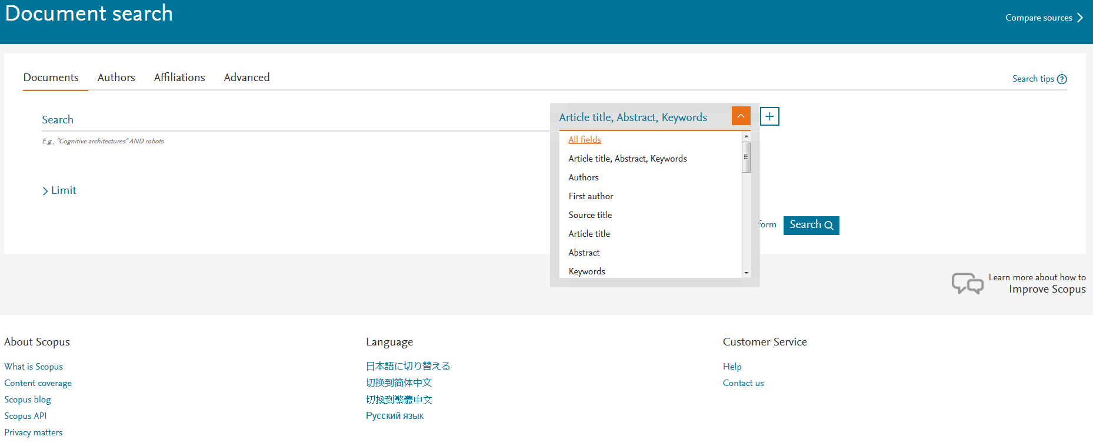
Why Scopus?
Great coverage: journals (over 21000), books, conference proceedings and more
Strict selection procedure: Scopus team aims indexing only the best content
User-friendly search platform
Great range of tools for data analysis
Available in most of Russian state organizations involved in R&D activities
ScienceDirect Journals and Books are now available nationwide!
© Eco-Vector

Slide 5
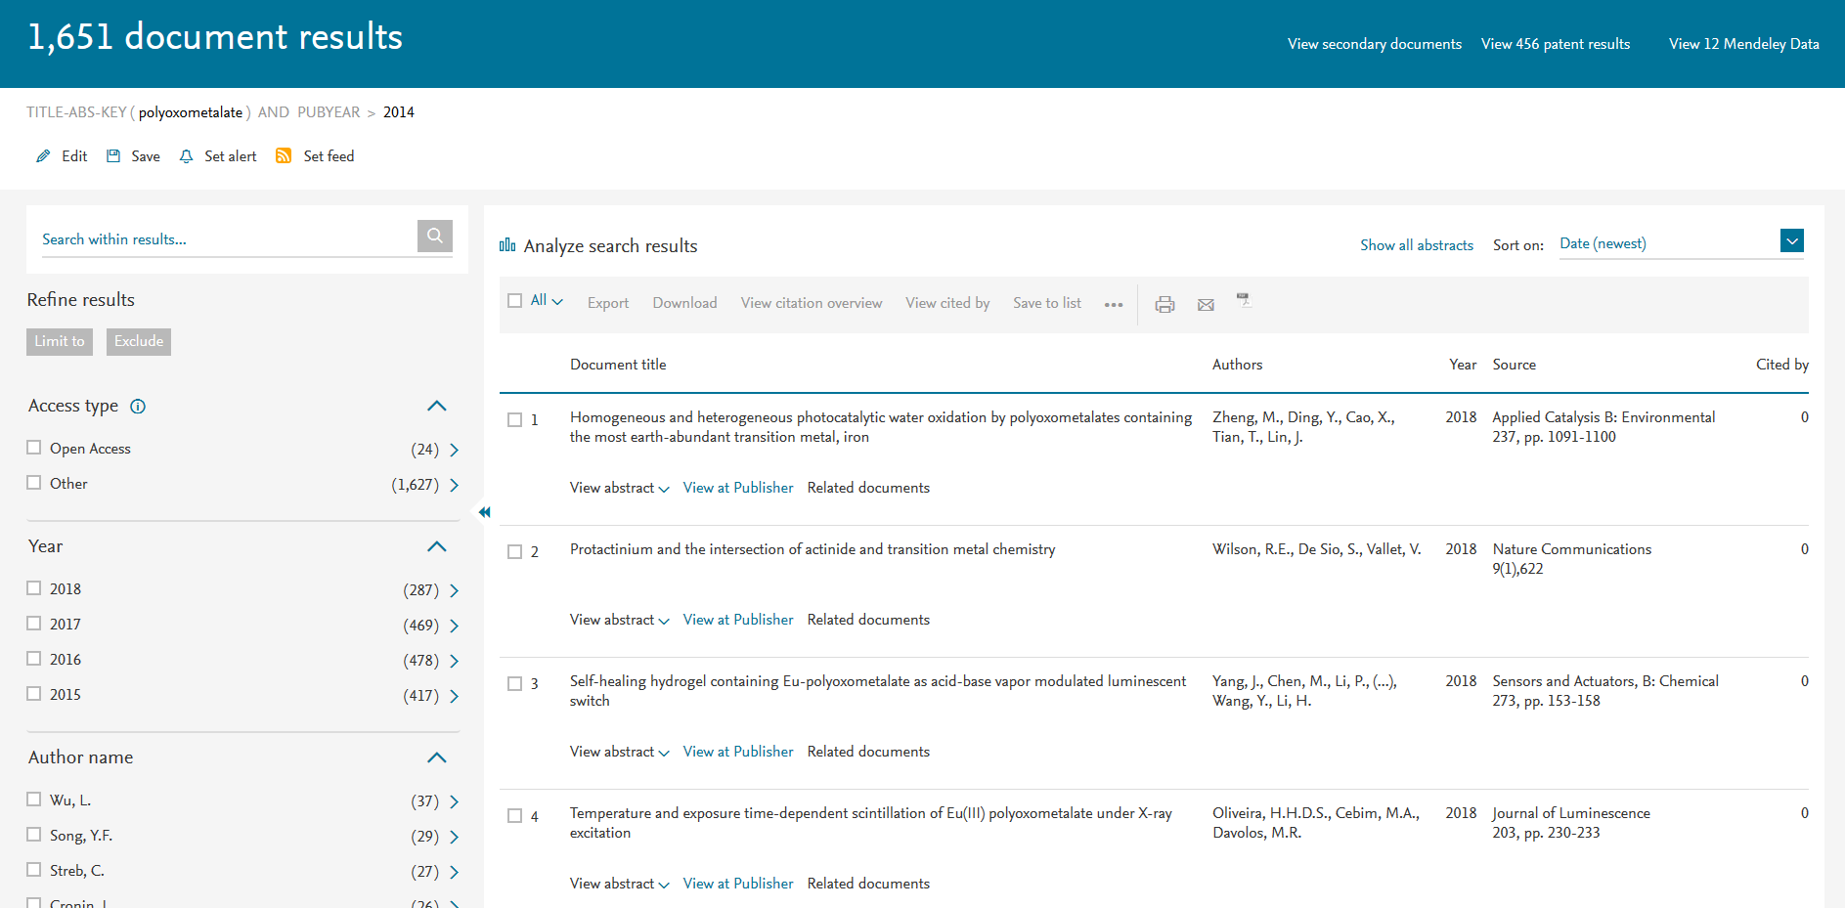
Scopus – primary search results
Number of records
Additional refining of results
Sorting by date, number of citations etc
A part of array can be selected
Clickable record (for each entry)
Direct link on the web version (via DOI)
© Eco-Vector

Slide 6
Scopus – entry
Authors, source etc
Cited by (only sources indexed in Scopus). Entries are clickable
You can trace the sources – both citing and cited, giving a partial image of “case story” within the research field
Full list of reference, clickable (if indexed)
ScienceDirect Journals and Books are now available nationwide!
© Eco-Vector

Slide 7
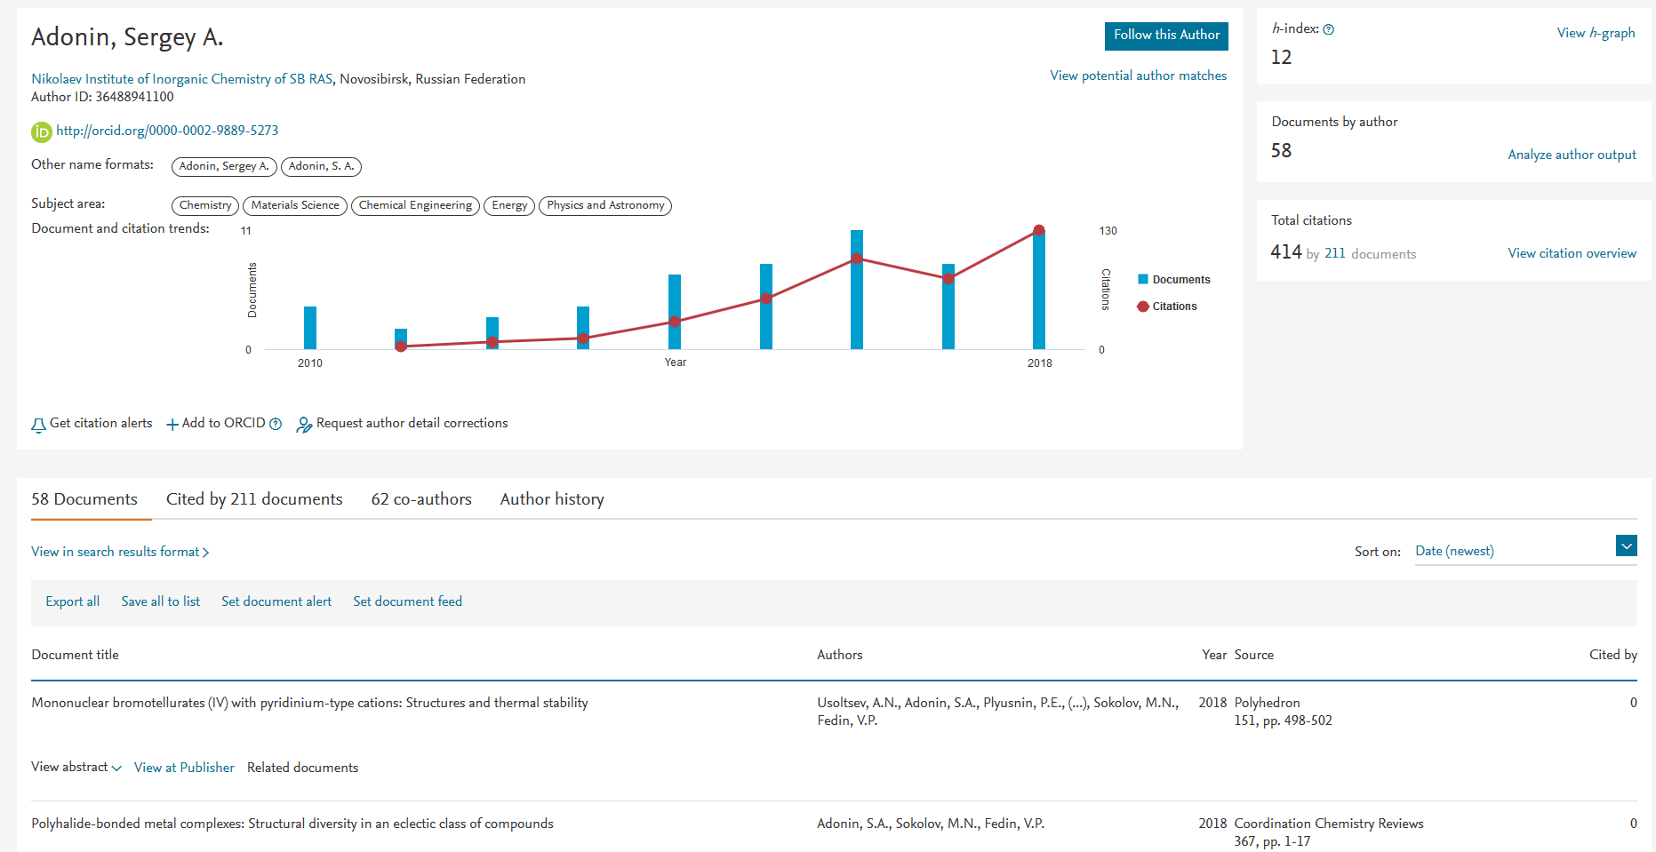
Scopus – author profile
Number of publications and citations by year
Following the author updates
Last affiliation and ORCID
List of publications (clickable)
ScienceDirect Journals and Books are now available nationwide!
© Eco-Vector

Slide 8
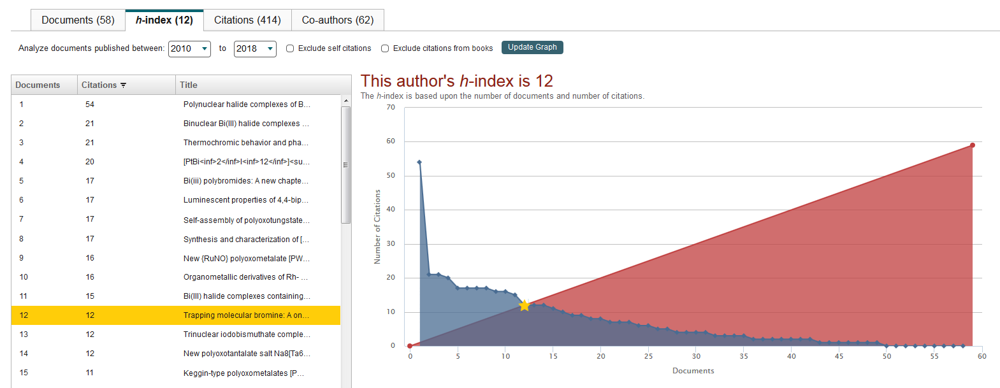
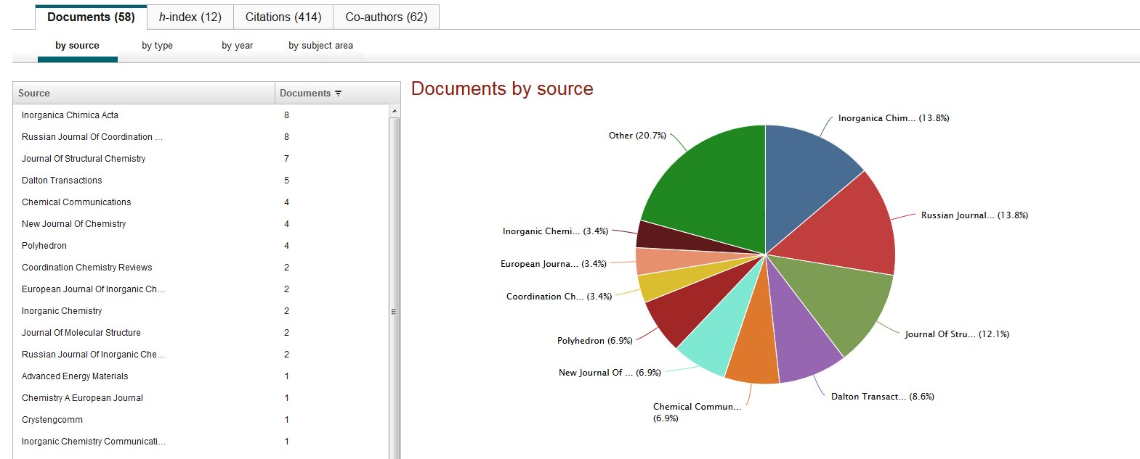
Scopus – author profile
H-index calculations…
…statistics on sources…
ScienceDirect Journals and Books are now available nationwide!
© Eco-Vector

Slide 9
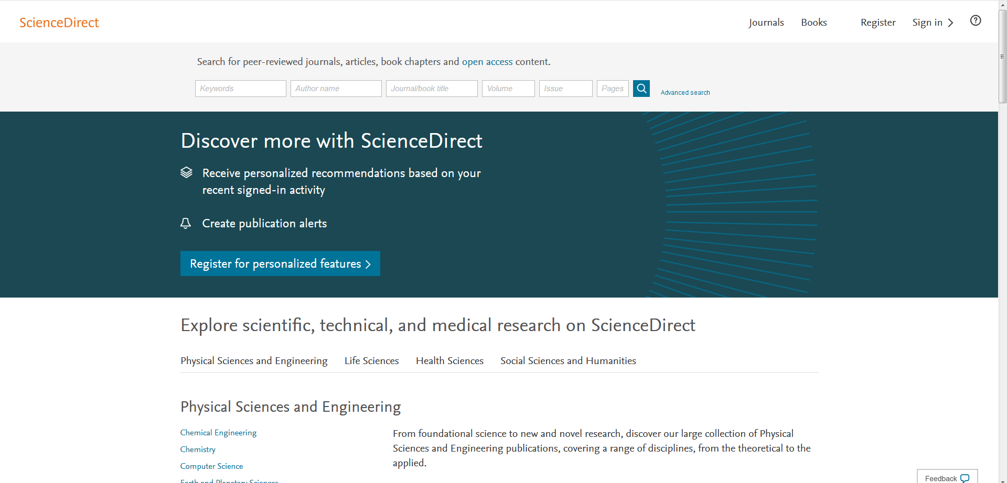
Sciencedirect: how it helps?
The platform for Elsevier journals and books
Since 2018, a great part of content is available nationwide!
Great variety of journals covering all (or virtually all) fields of research
ScienceDirect Journals and Books are now available nationwide!
© Eco-Vector

Slide 10
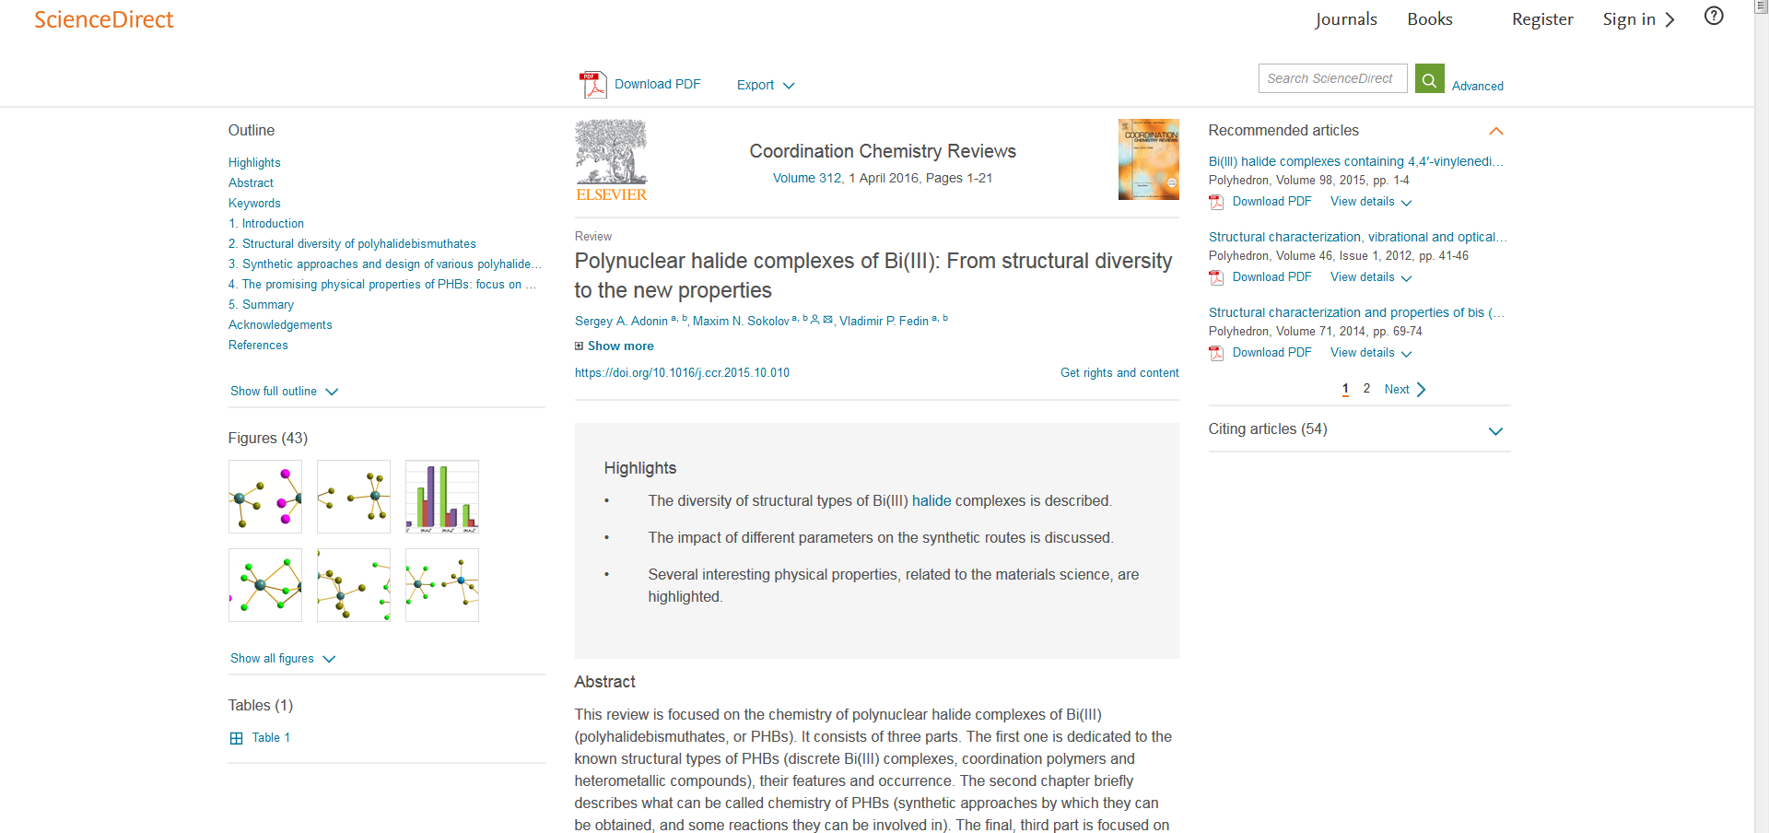
Sciencedirect: how it helps?
User-friendly interface
Search is very similar to Scopus
Articles can be downloaded (PDF), read online or imported into Mendeley
*Usually, we do not give this as a presentation. Instead, we demonstrate SD features in a “live” mode
ScienceDirect Journals and Books are now available nationwide!
© Eco-Vector

Slide 11
Working with references: useful tools
ScienceDirect Journals and Books are now available nationwide!
© Eco-Vector

Slide 12
Stages of working with literature
Search
bibliographic data
full text
Cataloging
saving the search results for future use
Use
Quick search for a certain information
Citing during writing of your own documents
Compiling bibliography, list of publications
ScienceDirect Journals and Books are now available nationwide!
© Eco-Vector

Slide 13
Item (with PDF) found. What next?
During search you mainly use a browser. Afterwards you need special tools
Main functions:
to save search results (everything that can be used in the future)
to find the required document (search through the bibliographic details or through the full text)
to create publications list or bibliography based on the selected items in any required format
to conveniently cite items inside a word processing software when writing your own papers, reports, etc.
General requirements:
support for many types of items (books, book chapters, journal papers, web links, dissertations, unpublished, etc.)
minimal number of mouse clicks/keystrokes
do not repeat identical actions (automate where possible)
ScienceDirect Journals and Books are now available nationwide!
© Eco-Vector

Slide 14
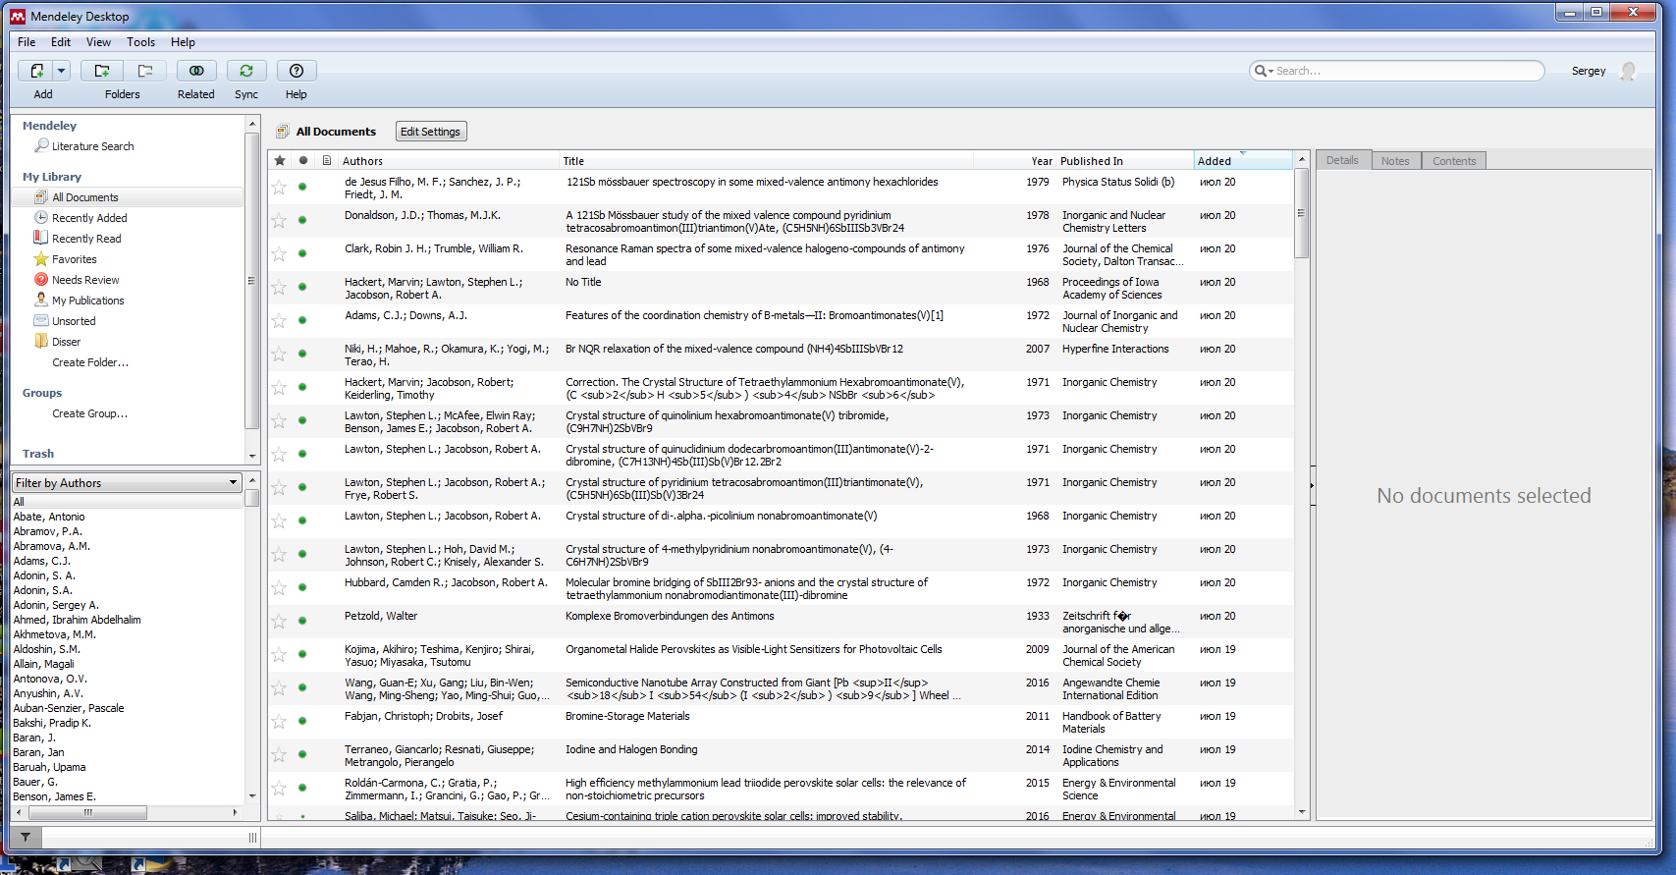
Mendeley – a powerful bibliography manager
Main components: “Mendeley Desktop” (software which should be installed), browser plugins, web cloud and MS Word (or other text editor) plugin
Most of the features are free
Fully automated generation of reference list
Step 1: install Mendeley Desktop and create an account
ScienceDirect Journals and Books are now available nationwide!
© Eco-Vector

Slide 15
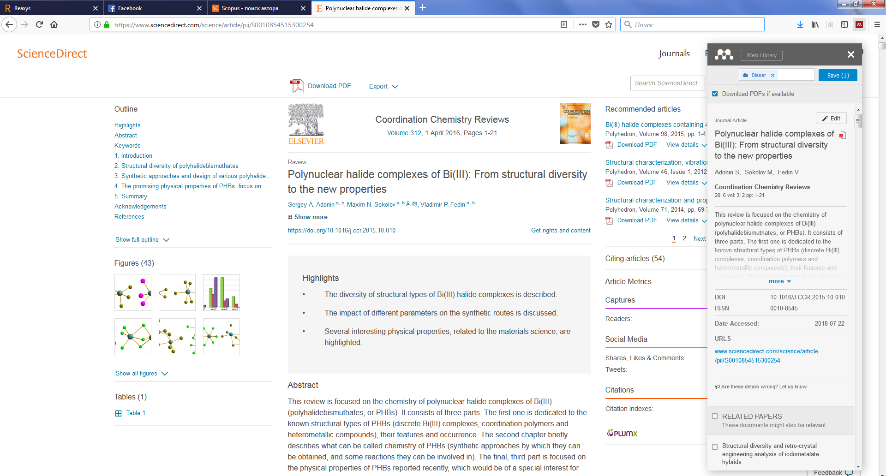
Mendeley – a powerful bibliography manager
Step 2: find what you would like to cite (in Scopus or in Web)
Get the data you need in two clicks
ScienceDirect Journals and Books are now available nationwide!
© Eco-Vector

Slide 16
Mendeley – a powerful bibliography manager
Step 3: synchronize with cloud
This feature allows working with your collection in any location with internet access
ScienceDirect Journals and Books are now available nationwide!
© Eco-Vector

Slide 17
Mendeley – a powerful bibliography manager
Step 4: insert reference and apply the required style
This is the most time-saving technology, especially when working with the texts with many references (books, reviews, big regular papers)
ScienceDirect Journals and Books are now available nationwide!
© Eco-Vector

Slide 18
You gathered a large literature database – share it
Many of the describe tools have web-components
You can synchronize the database between different devices
Or you can share the whole database with others (online)
Useful for collaboration
As demonstration of one of your results
ScienceDirect Journals and Books are now available nationwide!
© Eco-Vector

Slide 19
www.eco-vector.com
Sergey Adonin: FB, VK

