Slide 1





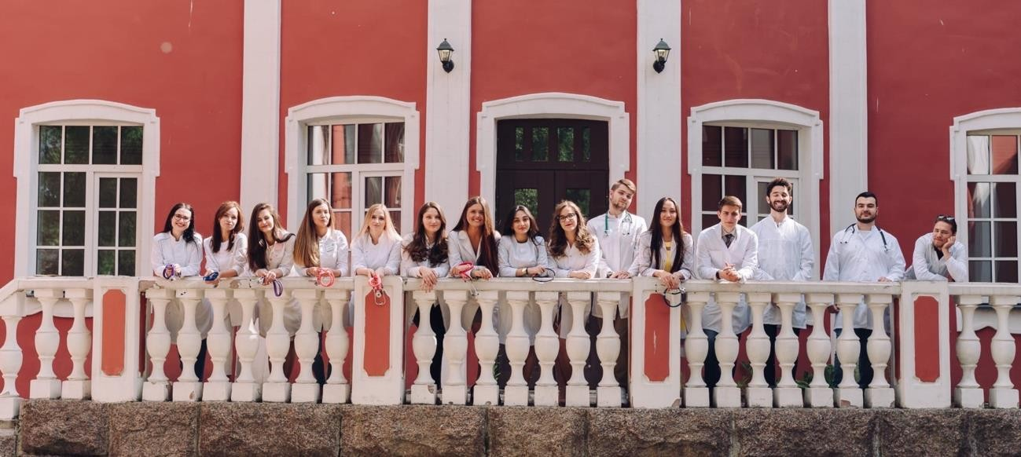
Dear freshmen 2023/2024 enrollment
Faculty of General Medicine NWSMU named after I. I. Mechnikov

Slide 2




N W S M U N A M E D AFTER I. I. M E C H N I KO V:
GENERAL INF O RMATIO N
4 5 0 0 +
students
4 0 0 +
foreign students
2 7 6 0 0 +
participants of the additional education programs
1 2 3 0 +
lecturers
7
faculties
8 4
chairs
6 4
partner universities from around the world
1 0 0 +
international
and scientific events
7 0 0 +
medical
practitioners
2 0 0 0 +
scientific
publications per year
9
research laboratories
4 5 +
patents on inventions per year

Slide 3

RESEARCH ACTIVITY
4 5 +
i n n o v a t i v e p r o d u c t s p e r year -
patents on i n v e n t i o n s
9 + 1
research laboratories and
institution
1
University
Center for Dental Research
2 0 0 0 +
scientific publications per year
2 0
grants per year

Slide 4

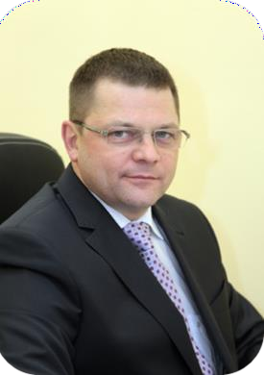

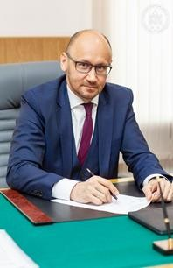
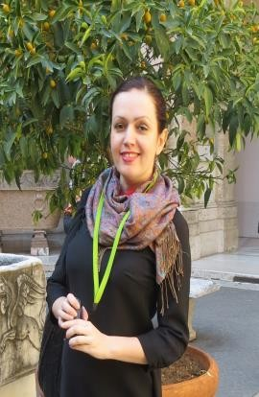
RECTORATE
The rector of the university, professor Sergey A. Sayganov
Vice-rector of academic affairs, professor Sergey A. Artyushkin
DEAN’S OFFICE
Dean of the Faculty, professor
Igor G. Bakulin
Dean assistant of faculty affairs
Anna V. Rikhter

Slide 5
CONTACTS DEAN’S OFFICE
1. Dean assistant of faculty affairs Anna V. Rikhter
address: Piskarevskiy pr. 47, complex 32, room 15
phone: (812)303-50-00, additional: 8612
e-mail: Anna.Rikhter@szgmu.ru
2. Document specialist Anastasiia A. Sapalyova
address: Piskarevskiy pr. 47, complex 32, room 15
phone: (812)303-50-00, additional: 8612
e-mail: Anastasiia.Sapalyova@szgmu.ru
Working hours (Monday-Friday):
12:00 – 13:00
15:00 – 17:00

Slide 6
OTHER USEFUL CONTACTS
1. Visa service
address: Piskarevskiy pr. 47, building 32, rooms 12 and 13
phone: (812)303-50-00, additional: 8569
e-mail: ovir@szgmu.ru
2. Account department
address: Piskarevskiy pr. 47, building 30, rooms 3 and 5
phone: (812)303-50-00, additional: 8306
e-mail: Elena.Miller@szgmu.ru
Working hours (Monday-Friday): 09:00 – 16:00

Slide 7
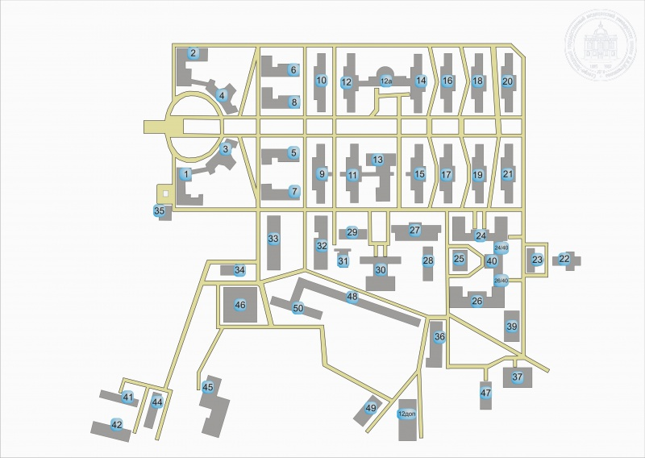
Siting of the complexes.
Piskarevskiy pr. 47

Slide 8
Building | Discipline
12 additional, 1st and 2nd floor | Fundamentals of Russian Statehood
 | History of Russia
2/4, 2nd floor | History of medicine
14 (right wing, 1st and 2nd floor) | Russian language
26,3rd floor | English language
32 (entrance opposite 31), 3rd floor | Latin
6, 1st floor | Psychology and pedagogy
26,4th floor (right wing) | Medical Physics, Biophysics
 | Information Technology in Medicine
5, 1st and 2nd floor | Chemistry
26, 2nd floor (left wing)
9, 3rd floor | Biology
11, 1st, 2nd and 3rd floor | Anatomy
6, 2nd floor | Basics of nursing staff professional activity
39 | Sports

Slide 9
Timetable of classes
Lectures | 1 | 08.30 – 09.15 09.20 – 10.05
 | 2 | 10.25 – 11.10
 |  | 11.15 – 12.00
 | 3 | 14.15 – 15.00
 |  | 15.05 – 15.50
 | 4 | 16.10 – 16.55
 |  | 17.00 - 17.45
Seminars | Morning | 09.00 – 10.30
 |  | 10.45 – 12.15
 | Afternoon/Evening | 13.10 – 14.40
 |  | or
 |  | 14:15 – 15:45
 |  | 14.55 – 16.25
 |  | or
 |  | 16:00 – 17:30

Slide 10

Starting date of education
The 1st day of you study is the 1st of November 2023
Your timetable (you have Flow E/поток И): https://szgmu.ru/rus/m/519/
All materials according to your classes will be sent to your emails

Slide 11




Medical gown and hat
Necessary to have in classrooms
Shoes (shoe covers)
Anatomical forceps (for anatomy class)
Materials for study
Stationery

Slide 12
Current announcement
Students who are in Saint-Petersburg have to come to the dean office on the 1st/2nd/3rd of November 2023 and bring 3 matte photos (3*4 sm, black and white) for making student ID cards.
Students who are abroad have to get in touch with visa service for preparing invitations from University. All details are here: https://szgmu.ru/rus/s/1136/
Link for tuition fee: https://szgmu.ru/rus/m/4576/

Slide 13





Congratulations on your admission to our University!
We wish you success in your studies!

