Slide 1
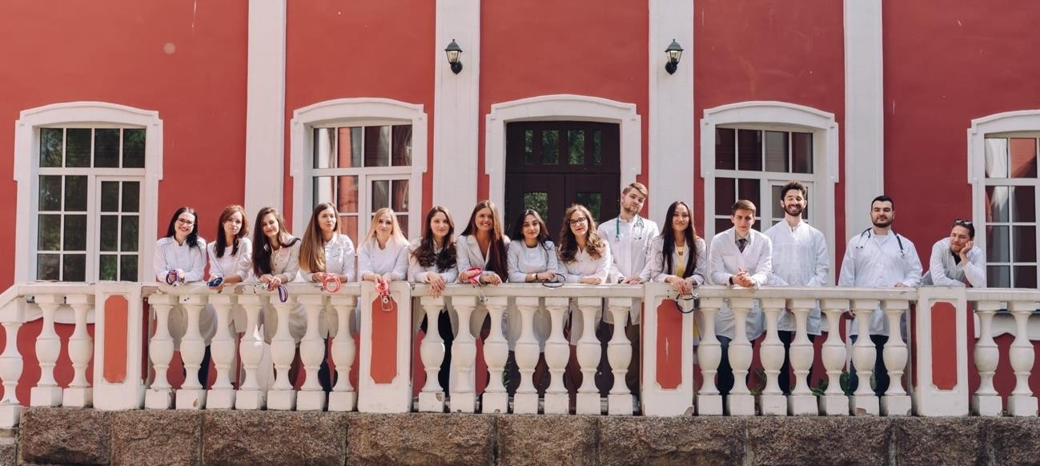
Dear freshmen 2024/2025 enrollment
Faculty of General Medicine NWSMU named after I. I. Mechnikov

Slide 2
N W S M U N A M E D AFTER I. I. M E C H N I KO V:
GENERAL INF O RMATIO N
4 5 0 0 +
students
4 0 0 +
foreign students
2 7 6 0 0 +
participants of the additional education programs
1 2 3 0 +
lecturers
7
faculties
8 4
chairs
6 4
partner universities from around the world
1 0 0 +
international
and scientific events
7 0 0 +
medical
practitioners
2 0 0 0 +
scientific
publications per year
9
research laboratories
4 5 +
patents on inventions per year

Slide 3
RESEARCH ACTIVITY
4 5 +
i n n o v a t i v e p r o d u c t s p e r year -
patents on i n v e n t i o n s
9 + 1
research laboratories and
institution
1
University
Center for Dental Research
2 0 0 0 +
scientific publications per year
2 0
grants per year

Slide 4
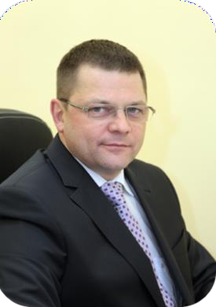
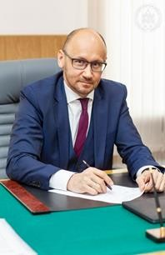
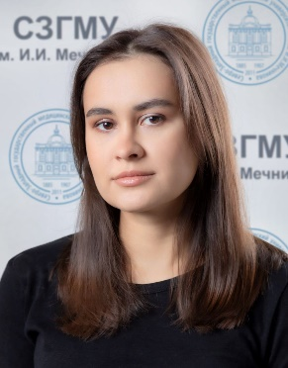
RECTORATE
The rector of the university, professor Sergey A. Sayganov
Vice-rector of academic affairs, professor Sergey A. Artyushkin
DEAN’S OFFICE
Dean of the Faculty, professor
Igor G. Bakulin
Dean assistant of faculty affairs
Anastasiia A. Sapalyova

Slide 5
CONTACTS DEAN’S OFFICE
1. Dean assistant of faculty affairs Anastasiia A. Sapalyova
address: Piskarevskiy pr. 47, building 32, room 15
phone: (812)303-50-00, additional: 8621
e-mail:Anastasiia.Sapalyova@szgmu.ru
2. Document specialist Yulia V. Zyabreva
address: Piskarevskiy pr. 47, building 32, room 15
phone: (812)303-50-00, additional: 8620
e-mail:
Working hours (Monday, Wednesday, Friday):
15:00 – 17:00

Slide 6
OTHER USEFUL CONTACTS
1. Visa service (OVIR)
address: Piskarevskiy pr. 47, building 32, rooms 12 and 13
phone: (812)303-50-00, additional: 8569
e-mail: ovir@szgmu.ru
2. Account department
address: Piskarevskiy pr. 47, building 30, rooms 3 and 5
phone: (812)303-50-00, additional: 8306
e-mail: Elena.Miller@szgmu.ru
Working hours (Monday-Friday): 09:00 – 17:00

Slide 7
First steps
1 Foreign students who arrived in Russia on the first day of arrival (except weekends) must report to office No. 12 of the Department of Visa Support and Migration Registration (Piskarevsky pr. 47, building No. 32 (AE) and present a package of documents:
passport;
notarized translation of the passport;
a migration card with a checkpoint stamp and the date of crossing the border of the Russian Federation, as well as indicating the purpose of arrival "study";
photo (10 pcs. 3x4 size on black and white or colored paper);
If you are a minor (i.e. you are under 18 years old) You must provide Consent from your parent or guardian. It must be translated into Russian and notarized.
In this department, you were given an initial application (with your photo), it must be returned to the OVIR no later than two days after arrival.

Slide 8
2 you need to do a fluorography, go to the clinic (building 24), but you need to do it before 15:00. If you do not have time or you are under 18, you can go to Tuberculosis Dispensary No. 5 (Противотуберкулезный Диспансер № 5) at Bestuzhevskaya str., 48
3 Then you go to the accommodation department (building 31, room 3, 4) with the fluorography and all the documents.
There you will be assigned to a dorm and you will get a room.

Slide 9
4 You should go to building 33, room 116. When checking the agreement, please make sure that your name, passport details, and full address in your country are indicated correctly.
Insurance is a mandatory document that is necessary for a foreign student. An insurance policy can be issued at the University (building 33, room 116). The cost is 4,500 rubles* (payment in cash only).
*the price may change
You can purchase policies from another company. Insurance must meet these requirements:
medical care provided by emergency medical stations (departments, points);
medical care in outpatient and inpatient medical institutions in case of sudden health disorders and accidents to the extent necessary to eliminate the threat to the patient's life and (or) relieve acute pain;
transportation by medical transport or other means of transport, including medical support (medical team, doctor, nurse), from the place of illness (accident) to a medical institution;
posthumous repatriation (transportation) of remains
Dean's Office, you must provide an initial application, 3 photos
5 Dean's Office. Here you have to provide an initial application, 3 photos

Slide 10
Visa and migration rules and laws
You should familiarize yourself with the laws of Russia. Ignorance of the law is no excuse.

Slide 11
Every foreign student is obliged to have health insurance (Migration Law). An insurance policy is purchased every year.

Slide 12
If the specialists of the OVIR or the dean's office tell you to come to the OVIR, you must do it on the same day.

Slide 13
You must always live at the place of registration.

Slide 14
You must keep track of the visa deadlines (you must submit all documents 45 days before the end).

Slide 15
You are obliged to pass an annual medical examination (without this, you may not be able to extend your visa).

Slide 16
You cannot leave St. Petersburg during the semester (even for one day), you can only travel during the holidays.

Slide 17
If you plan to leave, you must notify OVIR and the dean's office, as well as fill out an application, get signatures of a visa specialist, an accountant and a dormitory manager, and attach tickets there and back. The application must be returned to the dean's office.

Slide 18
Upon arrival, you must go to the OVIR on the same day. If your arrival day falls on a Saturday or Sunday, you must come to OVIR on Monday.

Slide 19
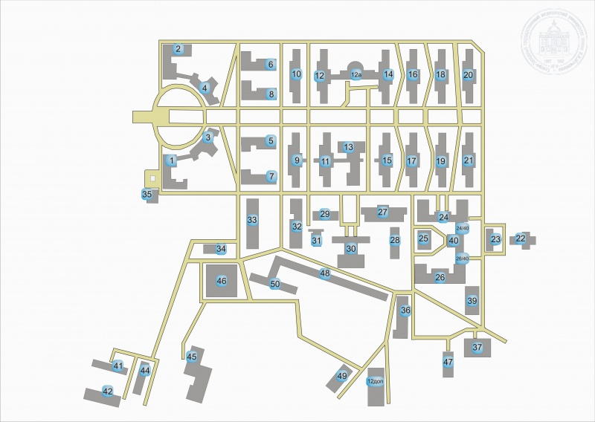
Siting of the complexes.
Piskarevskiy pr. 47

Slide 20
Building | Discipline
12 additional, 1st and 2nd floor | Fundamentals of Russian Statehood
 | History of Russia
2/4, 2nd floor | History of medicine
14 (right wing, 1st and 2nd floor) | Russian language
26,3rd floor | English language
32 (entrance opposite 31), 3rd floor | Latin
6, 1st floor | Psychology and pedagogy
26,4th floor (left wing) | Medical Physics, Biophysics
 | Information Technology in Medicine
5, 1st and 2nd floor | Chemistry
26, 2nd floor (left wing)
9, 3rd floor | Biology
11, 1st, 2nd and 3rd floor | Anatomy
6, 2nd floor | Basics of nursing staff professional activity
39 | Sports

Slide 21
Timetable of classes
Lectures | 1 | 08.30 – 09.15 09.20 – 10.05
 | 2 | 10.25 – 11.10
 |  | 11.15 – 12.00
 | 3 | 14.15 – 15.00
 |  | 15.05 – 15.50
 | 4 | 16.10 – 16.55
 |  | 17.00 - 17.45
Seminars | Morning | 09.00 – 10.30
 |  | 10.45 – 12.15
 | Afternoon/Evening | 13.10 – 14.40
 |  | or
 |  | 14:15 – 15:45
 |  | 14.55 – 16.25
 |  | or
 |  | 16:00 – 17:30

Slide 22
Starting date of education
The 1st day of you study is the 1st of October 2024
Your timetable (you have Flow E/поток И): https://szgmu.ru/rus/m/519/
All materials according to your classes will be sent to your emails

Slide 23
Medical gown and hat
Necessary to have in classrooms
Shoes (shoe covers)
Anatomical forceps (for anatomy class)
Materials for study
Stationery

Slide 24
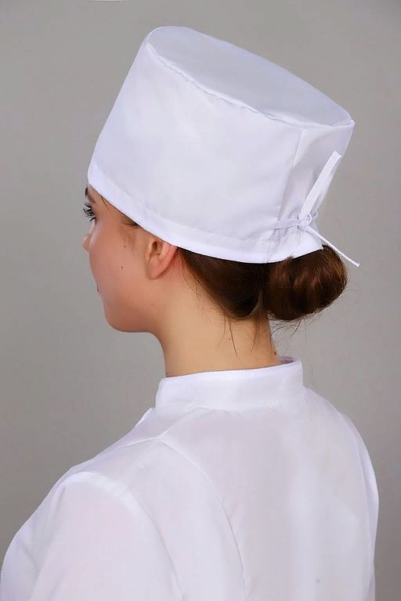
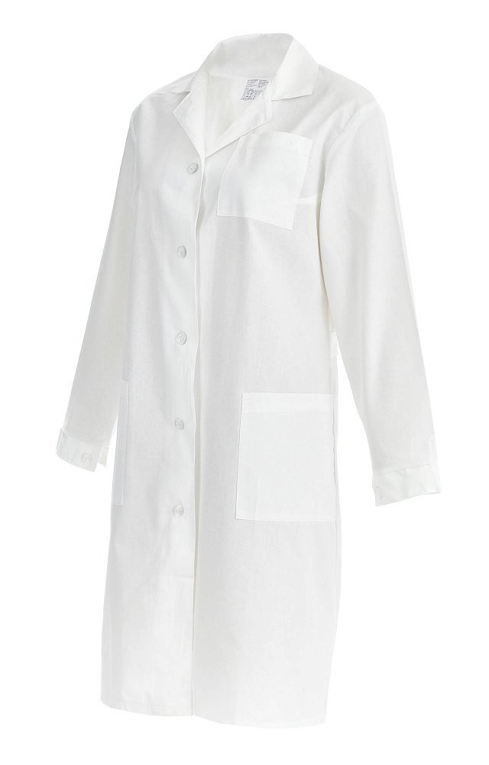
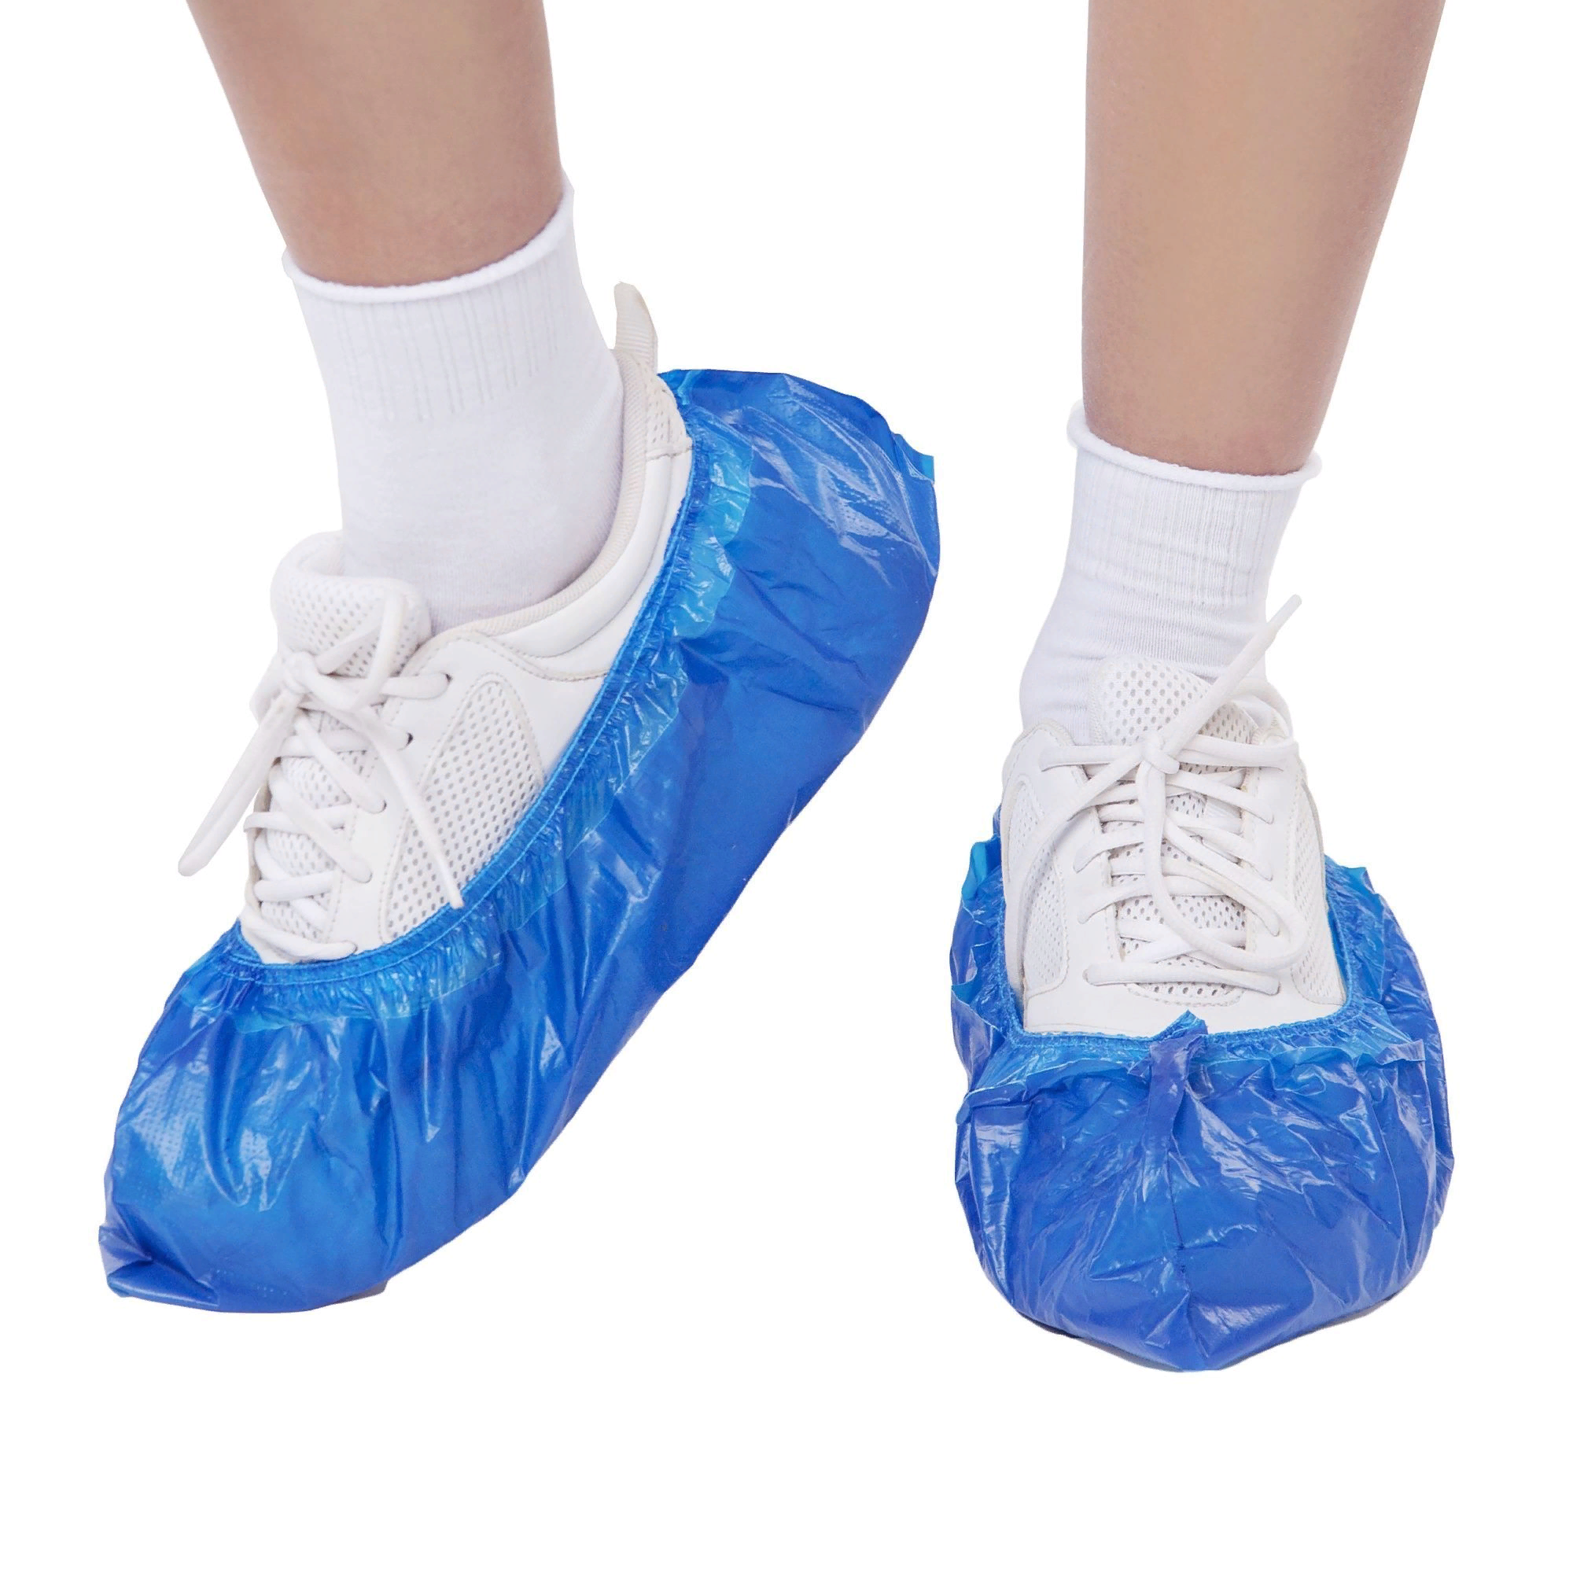
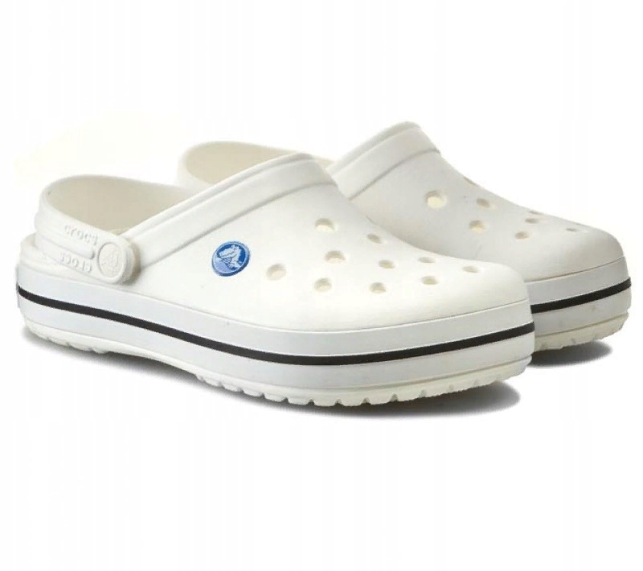
Uniform

Slide 25
Rules of etiquette at the university
Always arrive on time. Being late is prohibited.
Take off your outerwear and put on indoor shoes before classes start
Your phone must always be turned off during any class.
Greeting. The student must get up when any teacher enters the classroom.
You must be an active listener. You must participate in discussions and answer questions. If you have any questions, raise your hand and ask what you need, never interrupt your teacher.
Use English or Russian (NOT YOUR NATIVE LANGUAGE) to communicate in the classroom.

Slide 26
Take notes during lectures, seminars, and practicals. All the knowledge that you are given will be useful in seminars and practical classes, and especially in EXAMS.
Try to ask all your questions during class. If you suddenly have a question for the teachers, send them to the Moodle.
Use an official style in writing. Writing in private to any professor is prohibited. Only leader of the group can do it.
Write only during business hours. It's offensive to write late at night or at weekends.

Slide 27
Scheme of solving problems
You have a problem
Think thoroughly yourself (study the documents of the university https://szgmu.ru/rus/m/577 )
If you couldn’t find the answer
Consult with the leader and tutor
If you couldn’t find the answer
Finally, contact the dean's office during business hours (Monday, Wednesday, Friday) 15:00 – 17:00

Slide 28
Disciplines | Assessment | Semester
The fundamentals of Russian statehood | Credit test | I
History of medicine | Credit test | II
Latin language and fundamentals of terminology | Credit test | II
Psychology and pedagogy | Credit test | II
Medical Physics, Biophysics | Credit test | II
Chemistry | Exam | I
Biology | Exam | II
Anatomy | Credit test | I
Information Technologies in Medicine | Credit test | II
Basics of nursing staff professional activity | Credit test | II
Fundamentals of medical communication in English | Credit test | II
Practical training: introductory | Credit test | II

Slide 29
Absent classes
12 absent classes – official warning about possible expulsion
17 absent classes - official notification of expulsion
18 absent classes - expulsion without notification
If you are sick, you have to go to polyclinic (26 building) and take sick leave

Slide 30
Current announcement
Students who are in Saint-Petersburg have to come to the dean office on the 1st/2nd/3rd of October 2024 and bring 3 matte photos (3*4 sm, black and white) for making student ID cards.
Students who are abroad have to get in touch with visa service for preparing invitations from University. All details are here: https://szgmu.ru/rus/s/1136/
Link for tuition fee: https://szgmu.ru/rus/m/4576/

Slide 31
Congratulations on your admission to our University!
We wish you success in your studies!

